Slide 1
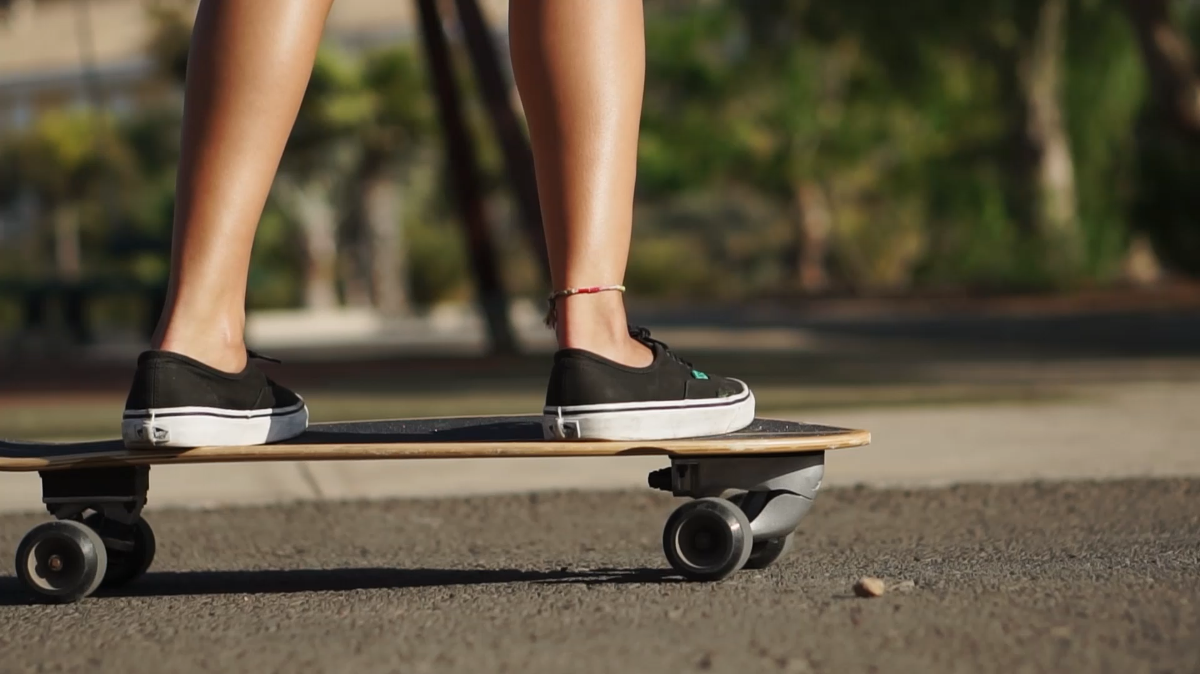
Notes:
Put a video, make sure it is looped
Then put a label centered, make sure it is big
Then put a rectangle in the left side. Right click, “edit points”, make some changes in the format
Click the label, then click the rectangle. Merge shapes, combine

Slide 2
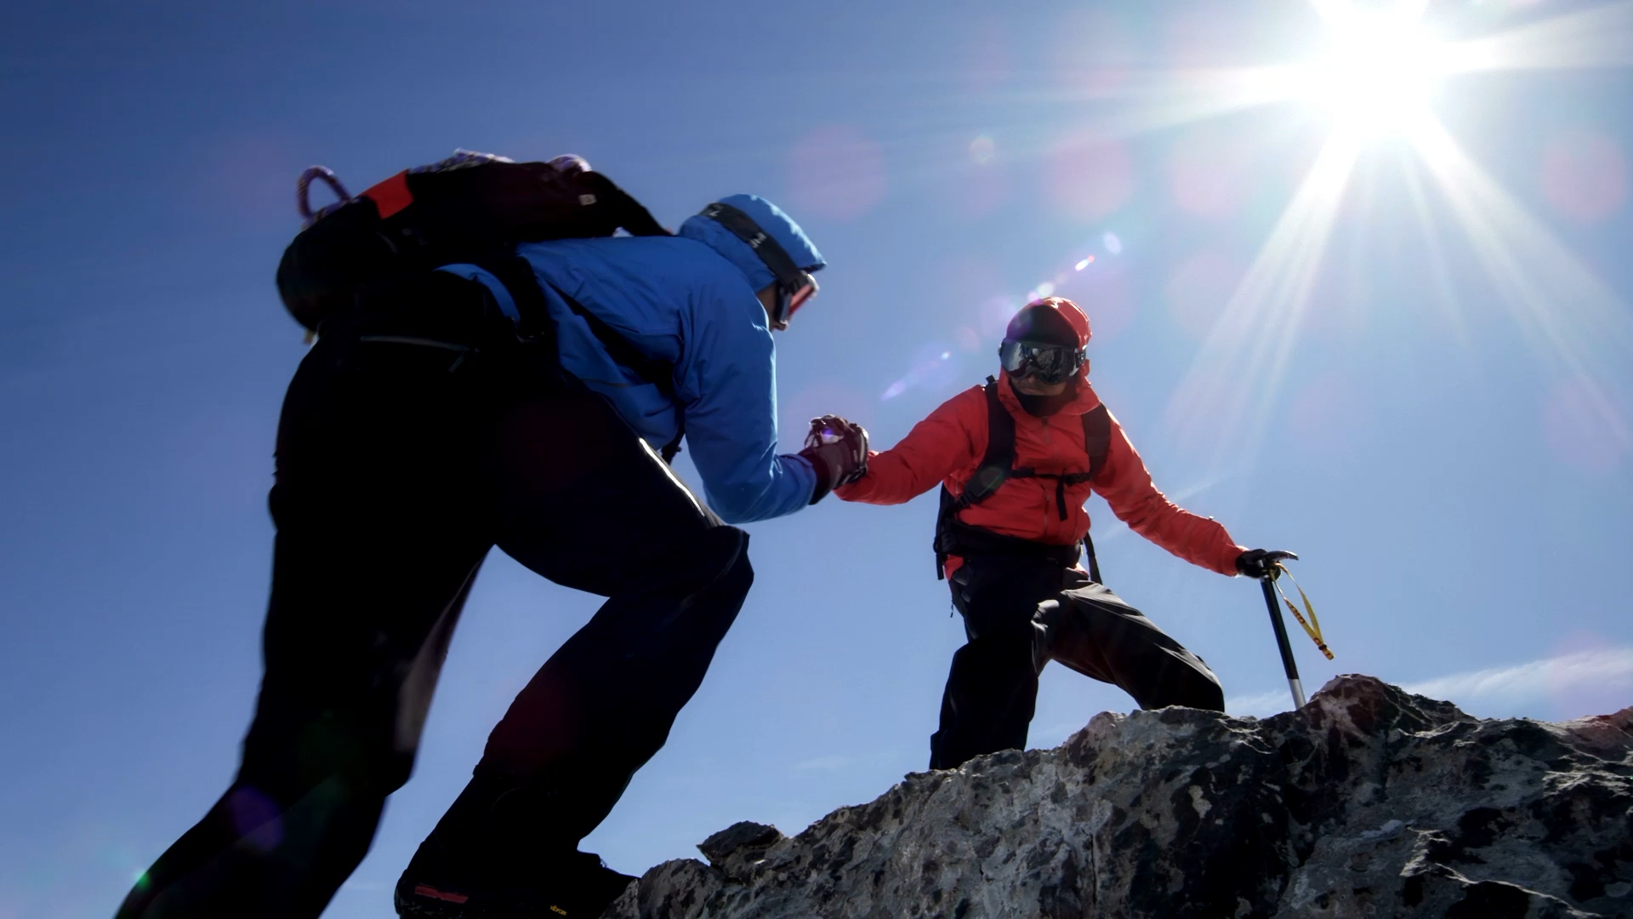
HELPING EACH OTHER IS CRUCIAL

